Slide 1
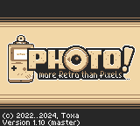
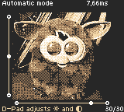
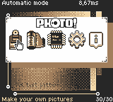
Boot screen
Camera mode
A/B/SELECT
(shortcut)
START
Main Hub

Slide 2
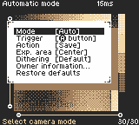
Main Hub
Camera mode
Resets default
Constrast/Brighness
in Auto mode
A
START
B
Performs autoexposure
in Assisted mode
SELECT
B
Camera menu

Slide 3
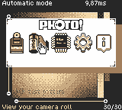
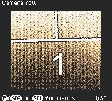
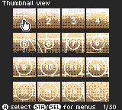
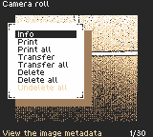
Main Hub
Gallery
Gallery viewer
A
A
START/B
SELECT
B
Gallery menu

Slide 4
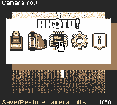
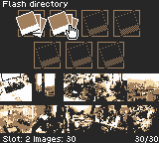
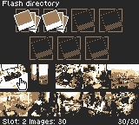
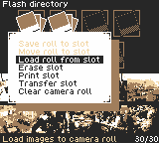
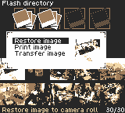
Main Hub
Slot select screen
Slot image viewer/printer
A
A
START/B
B
SELECT
B
SELECT
B
Flash storage menu
Roll menu

Slide 5
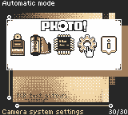
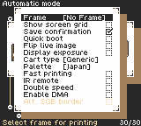
Main Hub
Settings menu
A
B

Slide 6
